Slide 1
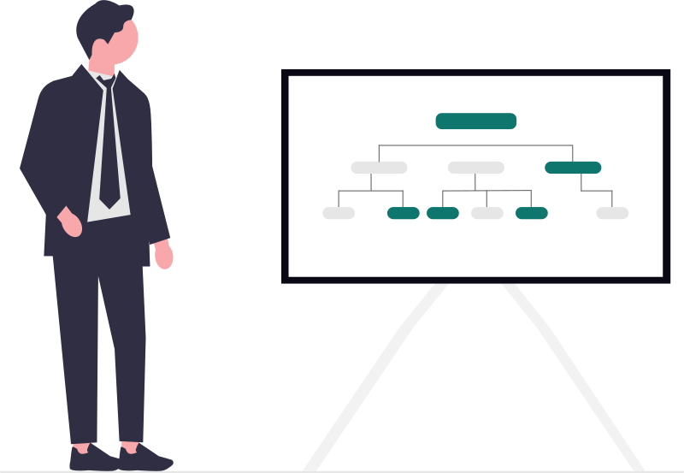
Phase 1 Functional flows
A new Service Plus for Karnataka
A full replacement for government service delivery
20 modules. Three types of service. Clear steps for citizens and officers.
For department review
We propose
1/37

Slide 2
Reading guide
How to read this deck
NIC says
A feature stated in the NIC slides.
We think
Our understanding. It still needs checking.
We propose
Our plan for the new system.
NIC has not told us
A detail missing from the supplied material.
Source: supplied material
2/37

Slide 3
The whole system
20 modules in five groups
People and offices
Service setup
Application work
Documents and money
Shared support
Accounts
Services
Work steps
Documents
Connections
Offices
Forms
Applications
Payments
Appeals
Roles
Rules
Officer work
Messages
Reports
Centres
Publishing
History
States
Import
We propose
3/37

Slide 4



Service types
Three ways a service can work
Inside the system
Apply
Officer decides
Collection only
Submit
Receive receipt
Another department
Choose service
Continue outside
A receipt is not approval. Outside results need confirmation.
We propose
4/37

Slide 5

01 People and offices
Accounts and login
What ServicePlus
has today
What we propose
Things to be
careful about
NIC says
Login choices
One account across services
Department decides access
Citizen and officer roles
Admin adds officers
Keep past actions
Source: NIC slides 5,7
5/37

Slide 6
02 People and offices
Offices and areas
What ServicePlus
has today
What we propose
Things to be
careful about
NIC says
Office structure
Share official office lists
Department approves areas
Posts and area mappings
Keep dated staff postings
Protect earlier decisions
Source: NIC slides 17
6/37

Slide 7
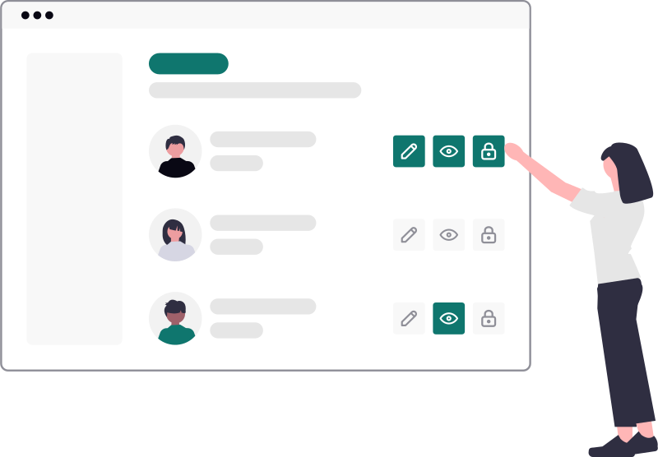
03 People and offices
Who can do what
What ServicePlus
has today
What we propose
Things to be
careful about
NIC says
Officer roles
Give access by duty
Department approves powers
Reports by role
Limit access by area
End temporary access
Source: NIC slides 7,16
7/37

Slide 8

04 Service setup
Finding the right service
What ServicePlus
has today
What we propose
Things to be
careful about
NIC says
Service setup
One service list
Department approves details
State and department pages
Show all three types
Explain fees and documents
Source: NIC slides 7,18
8/37

Slide 9
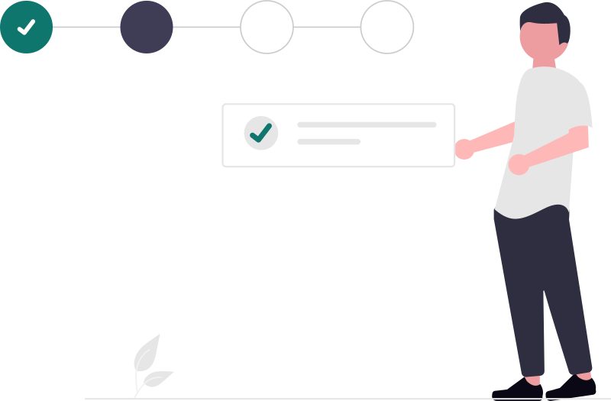
05 Service setup
Building application forms
What ServicePlus
has today
What we propose
Things to be
careful about
NIC says
Forms in several languages
Reuse approved fields
Department approves languages
Field checks and guidance
Preview before publishing
Keep submitted answers
Source: NIC slides 9
9/37

Slide 10

06 Service setup
Rules and fees
What ServicePlus
has today
What we propose
Things to be
careful about
NIC says
Rules and checks
Keep dated rules
Department approves exemptions
Conditional processing steps
Show how fees arise
Explain changed rule results
Source: NIC slides 5,9,11
10/37

Slide 11

07 Application work
Designing and running work
What ServicePlus
has today
What we propose
Things to be
careful about
NIC says
Changeable work steps
Designer sets steps
Department sets deadlines
Parallel checks and timers
System runs approved steps
Action codes 9/10/11: not confirmed
Source: NIC slides 11
11/37

Slide 12

07 Application work
How approved work steps run
Receive
application
Assign
officer
Check and
decide
Record
outcome
The designer sets the steps before launch.
Corrections needed
Officers follow the approved steps.
Return to applicant
Parallel checks join before the next decision.
Department names owners for delayed work.
We propose
12/37

Slide 13
08 Application work
Applying and saving progress
What ServicePlus
has today
What we propose
Things to be
careful about
NIC says
Self and assisted applications
Save unfinished forms
Department sets withdrawal rules
Online status and mobile access
Show each person’s applications
Check before resending
Source: NIC slides 7,14
13/37

Slide 14
09 Application work
The officer’s daily work
What ServicePlus
has today
What we propose
Things to be
careful about
NIC says
Officer roles
Show assigned applications
Department approves transfers
Ordered and bulk processing
Record decisions and reasons
Check every bulk action
Source: NIC slides 5,7
14/37

Slide 15

10 Documents and money
Certificates and other documents
What ServicePlus
has today
What we propose
Things to be
careful about
NIC says
Document templates
Keep original issued copies
Department approves signers
QR codes and stamps
Show whether still valid
Check actual signatures
Source: NIC slides 12
15/37

Slide 16
11 Documents and money
Payments and matching records
What ServicePlus
has today
What we propose
Things to be
careful about
NIC says
Payment connections
Check payment with provider
Department decides refunds
Benefit money through PFMS
Match bank and treasury records
Screenshots cannot prove payment
Source: NIC slides 13
16/37

Slide 17
11 Documents and money
How payments are checked
Work out
fee
Citizen
pays
Check provider
result
Match bank and
treasury records
Payment success does not approve the application.
Result unclear
Department decides refunds and benefit-payment rules.
Check again before retry
We propose
17/37

Slide 18

12 Documents and money
Messages to applicants
What ServicePlus
has today
What we propose
Things to be
careful about
NIC says
SMS and email
Use approved messages
Department approves channels
Sandes and WhatsApp
Keep delivery results
Message failure cannot change decisions
Source: NIC slides 10
18/37

Slide 19

13 People and offices
Help at service centres
What ServicePlus
has today
What we propose
Things to be
careful about
NIC says
Assisted applications
Record citizen’s permission
Department sets charges
CSC wallet connection
Identify centre and operator
Never share citizen passwords
Source: NIC slides 7,13
19/37

Slide 20
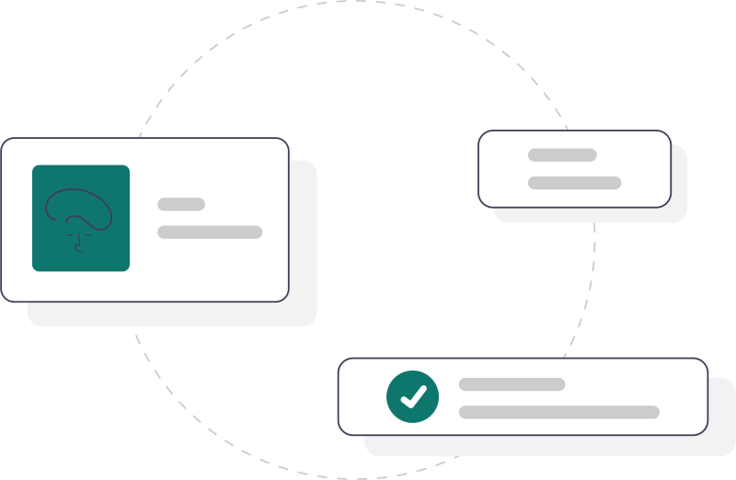
14 Shared support
Working with other systems
What ServicePlus
has today
What we propose
Things to be
careful about
NIC says
Outside data exchange
Reuse approved connections
Department approves sharing
Payment and document connections
Show failed checks clearly
Confirm each connection works
Source: NIC slides 13
20/37

Slide 21

15 Shared support
Complaints and appeals
What ServicePlus
has today
What we propose
Things to be
careful about
NIC says
Complaint tracking
Keep complaints and appeals separate
Department decides appeal rules
Up to three appeal levels
Link the original application
Record reasons
Source: NIC slides 15
21/37

Slide 22
16 Shared support
Reports officers can trust
What ServicePlus
has today
What we propose
Things to be
careful about
NIC says
Service reports
Use agreed counting rules
Department defines totals
Filters and controlled downloads
Show overdue work
Protect personal information
Source: NIC slides 16
22/37

Slide 23
17 Service setup
Publishing service changes
What ServicePlus
has today
What we propose
Things to be
careful about
NIC says
Service versions
Approve changes before launch
Department approves dates
Testing and launch stages
Keep earlier application rules
Plan withdrawal of changes
Source: NIC slides 5,19
23/37

Slide 24

18 Shared support
History and daily support
What ServicePlus
has today
What we propose
Things to be
careful about
NIC says
Work monitoring
Record who changed what
Department decides how long records stay
Officer reports
Show problem applications
Approve repairs
Source: NIC slides 7,11,16
24/37

Slide 25
19 Shared support
Each state’s own services
What ServicePlus
has today
What we propose
Things to be
careful about
NIC says
Support for separate groups
State owns department records
Department approves administrators
Common service tools
Give departments limited control
Keep states’ records separate
Source: NIC slides 20
25/37

Slide 26
19 Shared support
How state control is shared
State appoints
administrators
Department sets
offices
Office assigns
officers
Officer sees
permitted work
We propose separate records for each state.
Departments manage only their own services.
Department decides support access.
Past actions still show who did what.
We propose
26/37

Slide 27
20 Shared support
Bringing existing work across
What ServicePlus
has today
What we propose
Things to be
careful about
NIC has not told us
Export files
Import Karnataka services and applications
Department accepts matched totals
Current application stages
Keep old references
Preserve signed copies
Source: supplied analysis, section 15
27/37

Slide 28
20 Shared support
How existing applications move
List services
and records
Map old steps
to new steps
Trial import
and compare
Department
accepts results
Keep references, documents, payments and pending work.
Old export formats are not yet known.
Department decides how unresolved cases move.
We propose
28/37

Slide 29

Main journey
How a citizen applies
Choose
service
Fill form and
attach papers
Review details
and fees
Submit and keep
reference
Show who can apply and which office handles it.
Payment timing follows the service rules.
If submission is unclear, check before sending again.
We propose
29/37

Slide 30
Main journey
How an officer processes work
Open assigned
application
Check papers
and information
Record decision
and reason
Send outcome
to citizen
Only the authorised officer can act.
Some services need parallel checks or field visits.
Department decides deadlines and when to seek corrections.
We propose
30/37

Slide 31
Main journey
How a citizen sends corrections
Officer explains
corrections
Citizen opens
application
Citizen changes
allowed fields
Send back
for review
Keep the earlier answers and show the changes.
Department decides the reply deadline.
A correction request does not reject the application.
We propose
31/37

Slide 32
Main journey
Payment, decision and certificate
Confirm
payment
Officer records
decision
Authorised officer
signs
Citizen gets
document
The service decides when payment is due.
Payment does not mean approval.
Failed signing keeps the document pending.
Some services need neither payment nor certificates.
We propose
32/37

Slide 33
Main journey
Tracking an application
Open your
application
See current step
and office
Read action
needed
Get document
or seek help
Show application, payment and document status separately.
For outside services, show only verified progress.
Keep complaints and appeals linked to the application.
We propose
33/37

Slide 34
Main journey
Moving Karnataka to the new system
Rehearse
the move
Match records
and payments
Stop old intake
at agreed time
Open new
service
Department approves the switch and the fallback plan.
Keep new decisions and payments during any fallback.
Confirm who handles every pending application.
We propose
34/37

Slide 35
Decisions
What the department must decide
Services
First services, fees, papers and time limits.
People
Approvers, signers, centres and support owners.
Information
Languages, sharing rules and how long records stay.
The move
Source files, pending work, checks and switch date.
We propose
35/37

Slide 36
Words used
A few words explained
Service version
The rules used when an application was made.
Appeal
A request to review a decision.
Cutover
The agreed switch to the new system.
Tenant
A state and its departments.
We propose
36/37

Slide 37
Next steps
What happens next
Review these
functional flows
Agree the
solution design
Prepare the
technical design
The owner approves each phase before the next begins.
The detailed 94-slide appendix keeps the longer explanations.
We propose
37/37

